Slide 1
Current State of TDRP
November 2, 2022
Dave Vance: Executive Director
Peggy Parskey: Assistant Director

Slide 2
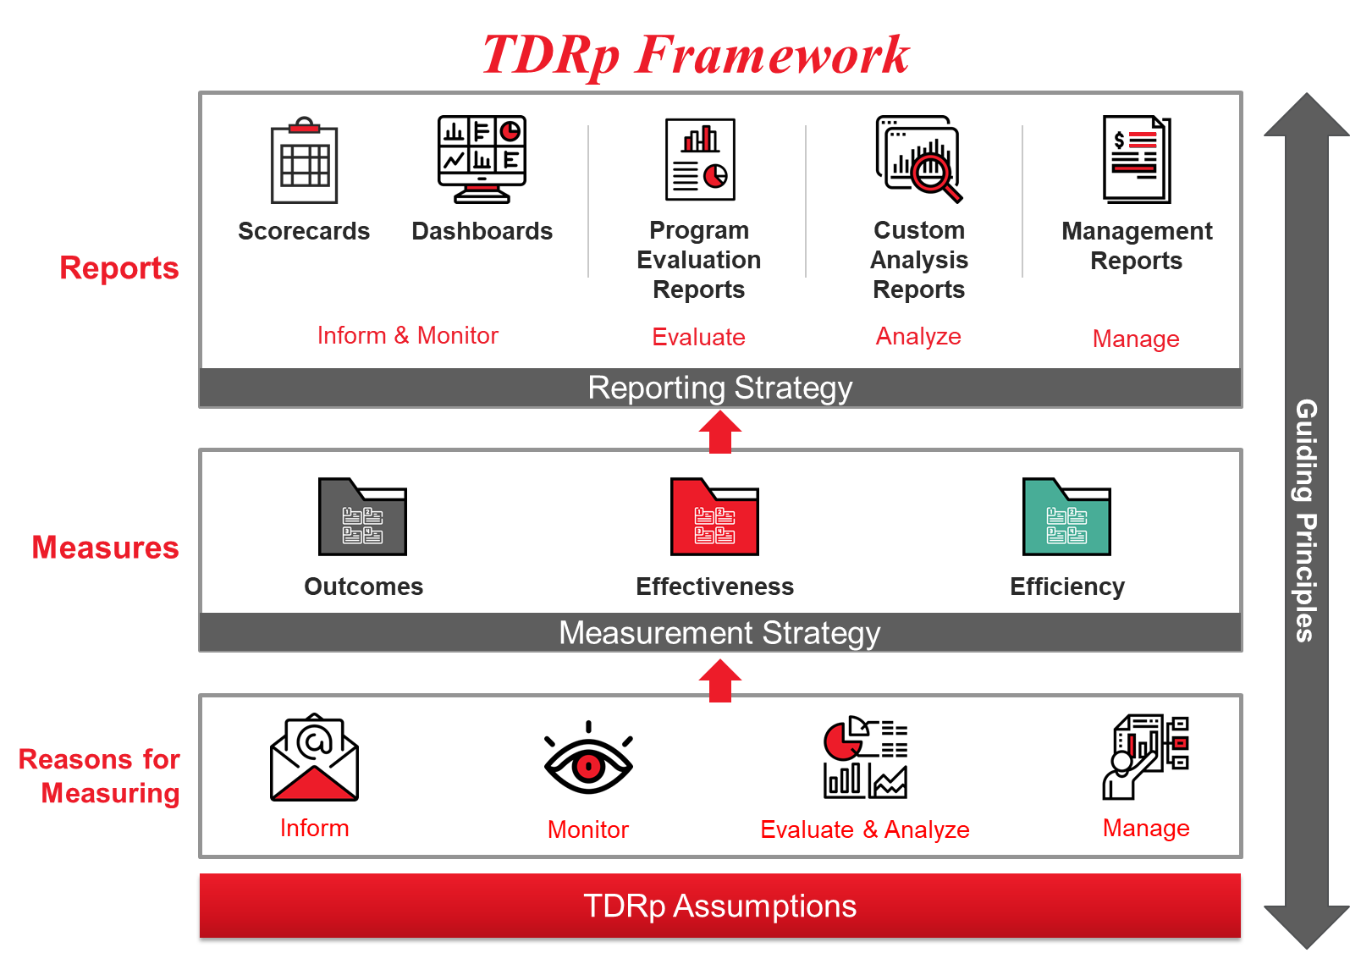

Slide 3
Reasons to Measure
Four high-level categories
  Inform
    Answer Qs about activity, identify trends
  Monitor
    Determine if measure is in line with historical expectations
  Evaluate & Analyze
    Determine the efficiency, effectiveness, and impact of a program. Identify opportunities for improvement
  Manage
    Plan to reach new goals, execute, make decisions
What is the focus for most measurement efforts?

Slide 4
Measurement Hierarchy

Slide 5



Three Types of TDRp Measures
Efficiency: quantity, volume, utilization, cost of program or initiative
  Individual programs and for enterprise overall
  Examples: Number of participants, courses, hours, cost, completion dates, utilization rates, cycle times
Effectiveness: quality of program or initiative
  Individual programs and for enterprise overall
  Examples: Participant reaction to the training, goal owner or sponsor satisfaction, learning, application, reinforcement, supervisor support, ROI
Efficiency
Effectiveness
Outcomes: impact of learning initiatives on organizational goals
Will be a different set for each organization because goals and initiatives are different
Common outcome measures are impact of learning on: sales, cost, quality, employee engagement, leadership score, and customer satisfaction
Outcomes
Notes:
In the early days, just two categories. John Boudreau and Peter Ramstad developed the HC Bridge Framework

Slide 6



Connecting the Dots
Efficiency
Effectiveness
Outcome
Level 0
Level 1
Level 2
Level 3
Level 5
Level 4
Activity measures
Reaction, recommend
Learning
Application
ROI
Business impact

Slide 7
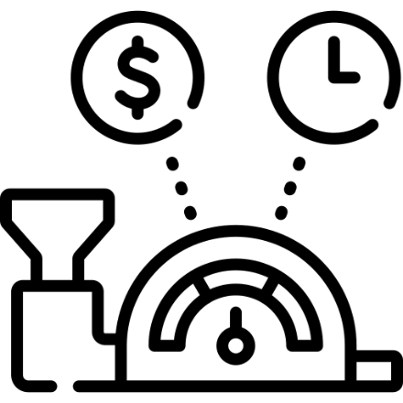
L&D Efficiency Measures
Also called Level 0, activity, or volume measures
Most basic type of measure
  Includes inputs, outputs and measures of productivity or utilization
  Number of participants (unique vs total participants)
  Courses delivered; hours consumed
  Completion dates
  Costs are an important Level 0 measure
About 150 of the 170 L&D measures in the CTR library
Be sure to capture all necessary level 0 measures

Slide 8






Taxonomy of Efficiency Measures for Formal Learning
Volume of participants, classes, courses (registrations & completions)
Availability and utilization
Cost to produce training by type and per student trained
Cost
Activity
Measures the duration of the design, development and deployment processes
Who is being trained relative to our target audience?
Formal
Learning
Cycle Time
Reach
Measures the level of effort (in hours) to design, develop and deploy training
Effort
Staff
Measures # and types of resources (FTEs) required to produce training
Most common

Slide 9
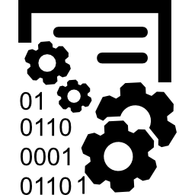
Recommended Efficiency Measures:
L&D Programs
At a program level
  Number of unique and total participants
  Reach
  Completion rate
  Completion date
  Cost
At the enterprise level
  Number of unique and total participants
  Number of courses
  Hours
  Percentage on-time completions
  Reach
  Cost
  Utilization measures (e.g., instructors, licenses)
By modality, business unit, area of learning or other key demographics

Slide 10

Recommended Effectiveness Measures:
L&D Programs
At a program level
  Level 1 Participant reaction
  Level 1 Goal owner reaction
  Level 2 Learning as appropriate
  Level 3 Application for most programs
  Level 5 ROI for key programs
At a department level
  Average/distribution of level 1 participant reaction
  Average/distribution of level 1 goal owner reaction
  Average/distribution of level 2 as appropriate
  Average/distribution of level 3 for most programs
  Summary of level 5 for key programs

Slide 11

Outcome Measures: About Results and Impact
(also known as Level 4)
Katzell / Kirkpatrick level 4: The business results following the training
  For example, sales increased 10% after sales training
  The result is the 10% increase in sales
Phillips level 4: The isolated impact of learning on business results
  For example, sales increased 10% after sales training, and 3% of the 10% increase was due just to the learning
  The outcome measure is stated as
    The impact of learning on ___________ (fill in the organization goal) was X
    In the above example, it would be: The impact of learning on sales was 3%

Slide 12
Most Common Outcome Measures for L&D
Impact of learning on sales, revenue, or budget
Impact of learning on productivity, quality or efficiency
Impact of learning on customer, patient, or student satisfaction
Impact of learning on accidents or injuries
Impact of learning on number of customers, students, market share
Impact of learning on employee engagement
Impact of learning on leadership score on employee engagement survey

Slide 13
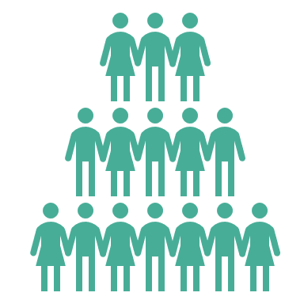




Five Methods to Isolate the Impact of Learning
Control group (the best)
Trendline
Regression (uses statistics)
Participant estimation (most common)
Expert opinion

Slide 14

Choosing your Measures
Always have a balance between efficiency and effectiveness measures
  Both quantity and quality are important
  Including both types will reduce unintended consequences
Include an outcome measure when supporting key goals
This will be your measurement strategy
For programs aligned to key goals
  Efficiency measures: Number of participants, completion rate, completion date, cost
  Effectiveness measures: At least levels 1-3. Ideally 5 as well
  Outcome measure: Level 4

Slide 15
Choosing your Measures (continued)
Basic skills, reskilling, and new hire learning
  Efficiency measures: number of participants, completion rate, completion date. cost
  Effectiveness measures: Levels 1, 2, and 3
  Outcome measure: None
For compliance learning
  Efficiency measures: number of participants, completion rate, completion date. cost
  Effectiveness measures: Levels 2 and 1 and perhaps 3
  Outcome measure: May not be one
No extra credit for hundreds of measures!
For discretionary learning (voluntary, general studies)
  Efficiency measures: number of participants, utilization rate, cost
  Effectiveness measures: Level 1
  Outcome measure: None
For informal learning (CofP, performance support, online content)
  Efficiency: participants, usage, utilization rates and cost
  Effectiveness: satisfaction and perhaps application
  No outcome measure

Slide 16
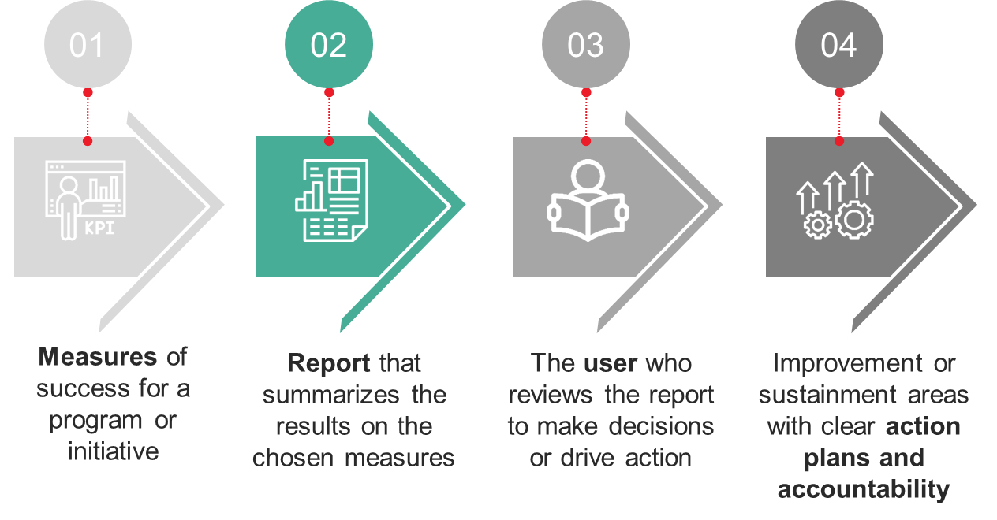
Reports Are the Connection Between Measures and the Users
The critical role of reports
  Measures => Reports => User =>Actions
Reports should be designed to provide the user with the information they want in the way they want it (content, format, frequency)
  Scorecards
  Dashboards
  Program evaluation and custom analysis reports
  Management reports
This will be your reporting strategy

Slide 17
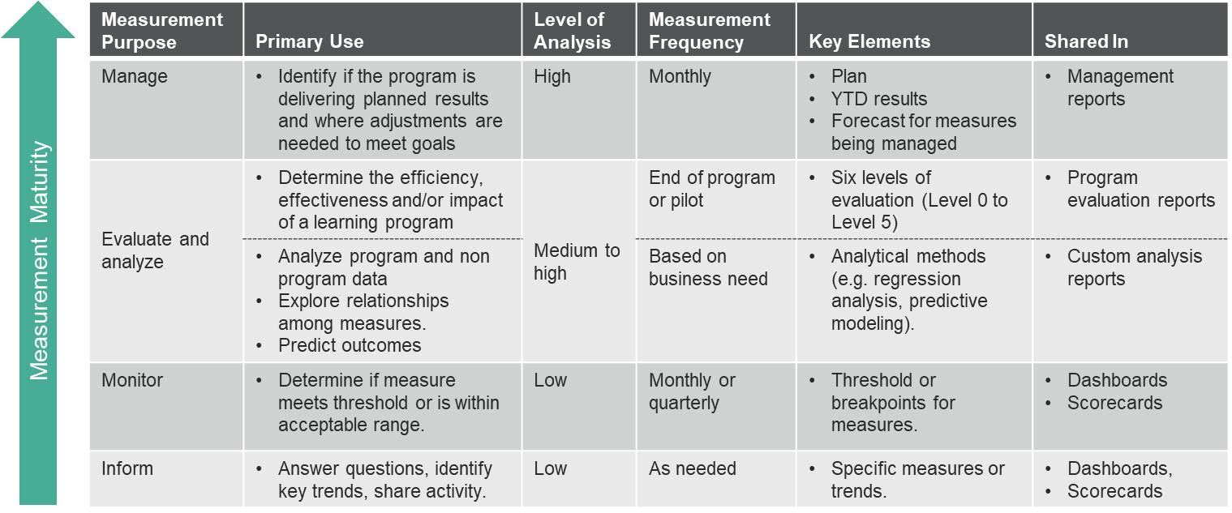
Measurement Requirements by Reason to Measure

Slide 18
Types of Reports
Scorecard or Dashboard to inform or monitor
  Typically shows only historical data
  Frequency may be monthly, quarterly or annual
  Good for sharing history and identifying trends. Good for monitoring
Program Evaluation Report to share evaluation results
  A one-off report to share results at the end of a program
  Excellent for project wrap up, identifying opportunities for improvement
Management Report to manage (Program, Operations, and Summary)
  Shows plan and progress compared to plan
  Forward looking, showing forecast and forecast compared to plan

Slide 19
Typical Scorecard – Purpose: Inform

Slide 20
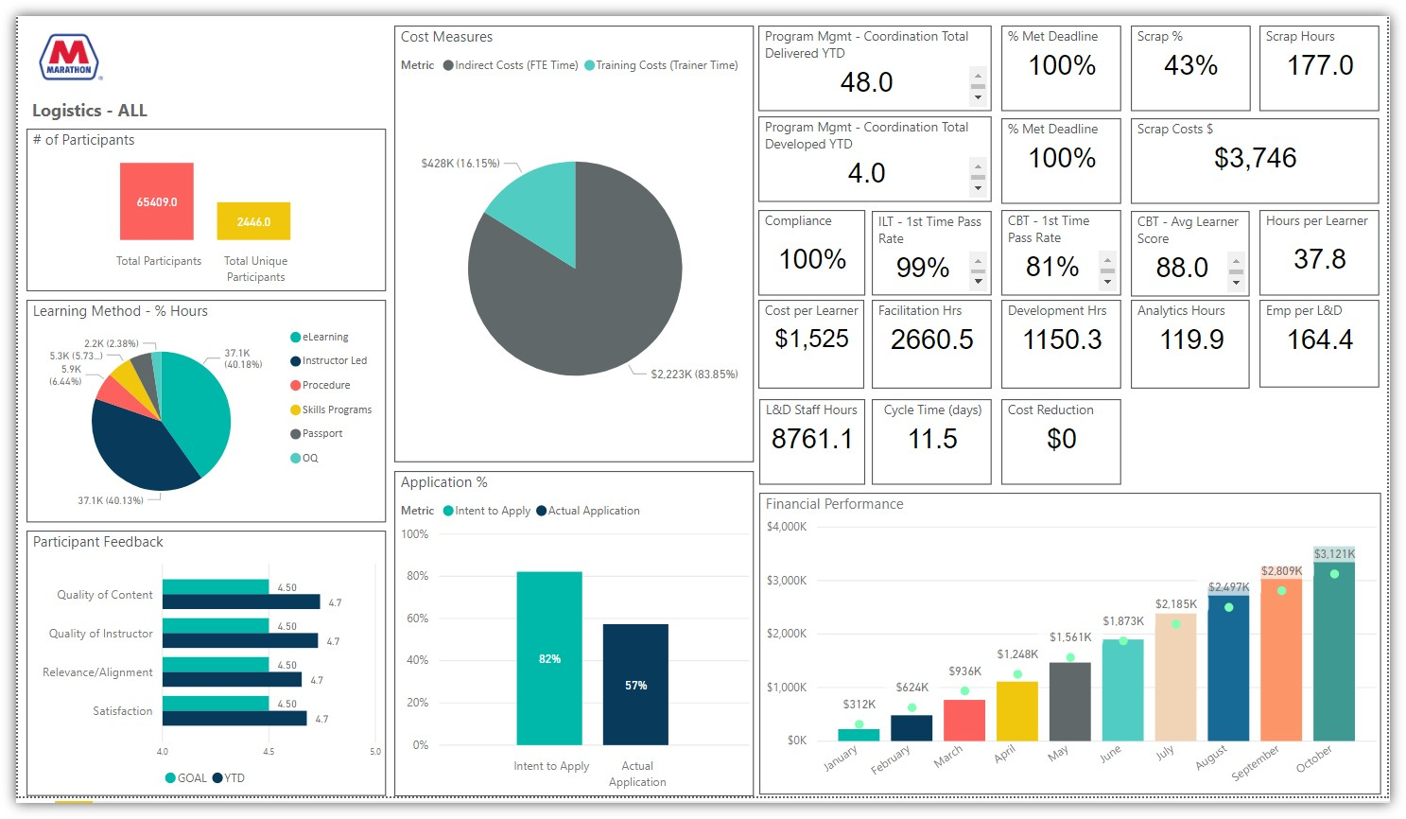
Typical Dashboard - Purpose: Inform

Slide 21
Typical Dashboard - Purpose: Monitor
Notes:
This is another view with color coding based on a rubric for performance

Slide 22
Program Evaluation Report
Purpose: Share evaluation results
One-off report
For sharing evaluation results of a program or initiative
Should contain relevant efficiency and effectiveness measures as well as an outcome measure if applicable
Should compare actual results to expectations
PPT or text

Slide 23
Program Evaluation Report
The following elements are recommended
  Goal or need to be addressed with context or background. Goal owner
  The proposed program with targets for key measures
  Results
  Lessons learned and opportunities for improvement

Slide 24
The Three TDRP Management Reports
Each designed to help leaders manage programs and the department
  Include only those measures to be managed
Designed to answer two fundamental business questions for successful execution
  Are we on plan year-to-date (YTD)?
  Will we make plan by the end of the year? (or how will the year end?)
Same columns for all three
  Plan, YTD Results, YTD Results vs Plan, Forecast, Forecast vs Plan
Three management reports
  Program, Operations, and Summary

Slide 25
Example of a Program Management Report for L&D
Purpose: Manage

Slide 26
Example Of An L&D Operations Management Report
Purpose: Manage Initiatives

Slide 27
Any questions about TDRP?

Slide 28

Breakout #4: What Elements of TDRP Have You Used or Might You Use?
For the next 27 minutes we will go into Breakouts to share elements of TDRP you have used or might use in the future (New breakout groups)
Discussion might include
  Your use of the language for three types of measures
  Your use of recommended measures or reports
  What would like to know more about?
We will bring you back after 27 minutes

Slide 29

Questions and Sharing about Elements of TDRP Used or of Interest
Questions on the current TDRP framework?
  Put in chat or raise hand
Sharing of elements used
  Post a few of your key useful elements in the Whiteboard or chat

