Slide 1
History and Evolution of TDRP and CTR
Dave Vance: Executive Director
Peggy Parskey: Assistant Director

Slide 2
History of Talent Development Reporting Principles (TDRP)
Kent Barnett (then CEO of Knowledge Advisors), Tamar Elkeles (then VP of Learning for Qualcomm), and a few others were having drinks at the Fall CLO Symposium in September 2010
They thought the time was right to bring GAAP-like standards to the L&D profession
Kent and Tamar agreed to form a council composed of industry thought leaders and practitioners to create these standards
Knowledge Advisors would fund initial development
Kent recruited Dave Vance and Peggy Parskey to provide leadership to the effort
Work began in October 2010 on the first draft of a White Paper

Slide 3
Council Members: Thought Leaders (Organization in 2010)
Kent Barnett (Knowledge Advisors)
Jac Fitz-enz (Human Capital Source)
Josh Bersin (Bersin & Associates)
Laurie Bassi (McBassi & Associates)
Jack Phillips (ROI Institute)
Rob Brinkerhoff (Western Michigan University)
Frank Anderson (Defense Acquisition University)
Jeff Higgins (HCMI)
Kevin Oakes (i4cp)
Peggy Parskey (Parskey Consulting)
David Vance (Manage Learning)

Slide 4
Council Members: Leading Practitioners (Organization in 2010)
Tamar Elkeles (Qualcomm) Council Chair
Carrie Beckstrom (ADP)
Sandy Shaw (Sodexo)
Terry Bickham (Deloitte)
Karen Kocher CIGNA)
Marilyn Figlar (Lockheed Martin)
Deb Tees (Lockheed Martin)
Sundar Nagarathnam (Net App)
Don Shoultz (BP)
Tom Simon (CNA Insurance)
Cedric Coco (Lowes)
Kevin Jones (PwC)
David Kuhl (First Data)
Claudia Rodriguez (Motorola Solutions)
David Sylvester (Booze Allen Hamilton)
Lou Tedrick (Verizon)
Sandra Dillon (E&Y)

Slide 5
Phase I: Initial White Paper Drafted and Approved
Dave and Peggy created a White Paper with a measurement and reporting framework for L&D
Three types of measures
Efficiency: quantity and activity measures, level 0
Effectiveness: quality measures, levels 1-3, 5
Outcomes: Results or impact, level 4
Three types of statements: efficiency, effectiveness, and outcome
Three types of executive reports: program, operations, summary
Initially referred to as GARP (Generally Accepted Reporting Principles)
24 drafts required before the council approved the final White Paper in March 2011 at the Spring CLO Symposium

Slide 6
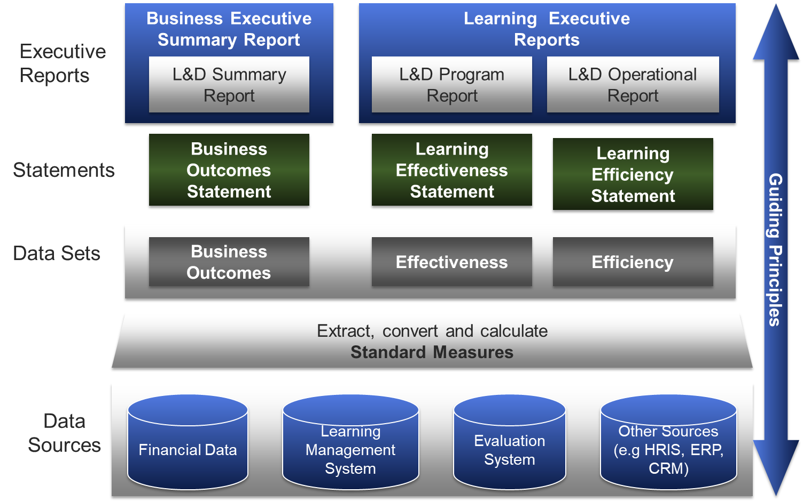
Executive Reporting Process

Slide 7
Buildout: April 2011 – July 2012
Phase II
Standards
Phase III
Framework Expanded
Phase IV
Collateral
L&D measures named and defined
White Paper expanded
L&D
Leadership development
Talent acquisition
Performance management
Capability management
Total rewards
Measures and statements libraries created
Name changed to Talent Development Reporting Principles (TDRP)

Slide 8
Creation of the Center for Talent Reporting (CTR) August 2012
TDRP needed a nonprofit home to preserve neutrality and independence
CTR created in August 2012 as a 501c6 nonprofit trade association
Dave Vance and Peggy Parskey named Executive and Assistant Directors
Board of Directors formed
Content will not be copyrighted and will be shared freely in word and PPT
Revenue generated primarily from members and sponsors
CTR would not offer consulting
Avoid competing with sponsors for measurement consulting
Activities to include
White papers
Webinars
Workshops
Conferences
Content on website

Slide 9
First Full-Year of CTR: 2013
Website goes live
Sponsors and members fund the start of CTR
Three sponsors have been with us since 2013
Knowledge Advisors/CEB/Gartner/Explorance
ROI Institute
Bellevue University’s Human Capital Lab
Two other sponsors with us for 8 of our 10 years
Caveo Learning and Skillsoft
Webinars, workshops, and monthly blogs begin
First CTR Conference held in Atlanta in October 2013

Slide 10
Executive Reporting Process
TDRp Framework
Senior Executives
Talent Development Executives
Executive Reports
Talent Development Summary Report
Quarterly
Talent Development Program Report (s)
Monthly
Talent Development Operations Report (s)
Monthly
Statements
Outcome
Statement
Effectiveness
Statement (s)
Efficiency
Statement (s)
Data Sets
Note:
Data sets can be organized by processes and/or efficiency, effectiveness & outcomes
Guiding Principles
Outcomes
Effectiveness
Efficiency
Talent Development Processes
Talent Acquisition
Leadership Development
Learning & Development
Capability Management
Performance Management
Total Rewards
Extract, convert and calculate Standard Measures
Data Sources
Financial Systems
Non-Financial,
non-TDR Systems
Evaluation, EOS Systems
Others: HRIS, LMS, CRM, ERP

Slide 11
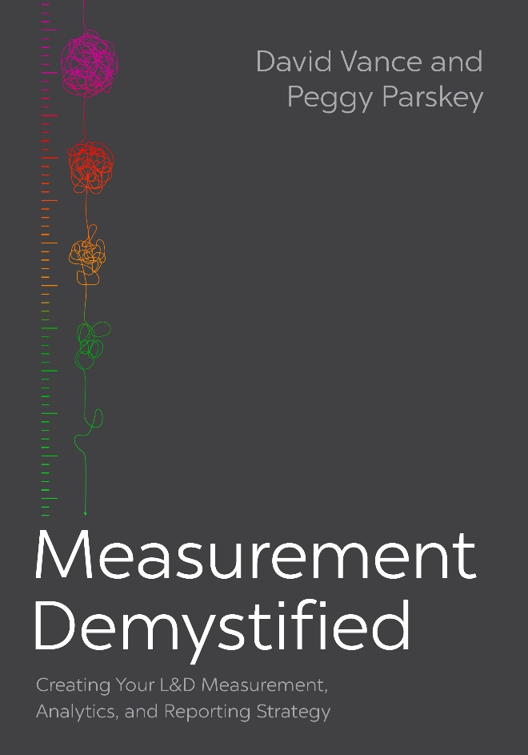
Evolution 2014-2022
Framework modified
More reports added (scorecards, dashboards, program evaluation)
Statements de-emphasized to avoid duplication with management reports
Reasons to measure added
Measures library expanded
January 2021: First book on TDRP published: Measurement Demystified
January 2022L Second book published: Measurement Demystified Field Guide
TDRP reflected in ISO Technical Specification TS 30437 L&D Metrics (June 2023)

Slide 13
Questions or Comments

Slide 14
Breakout #3: Take-Aways from the Last Two Sessions on the Need for TDRP and Its History and Evolution
For the next 7 minutes we will go into Breakouts to share take-aways
Same breakout members as last time
Discuss
What interested or surprised you?
What would like to know more about?
We will bring you back after 7 minutes
Type one surprise or take-away into Chat

