Slide 1
Lessons Learned: Unfinished Business and Recommendations
November 2, 2022
Dave Vance: Executive Director
Peggy Parskey: Assistant Director

Slide 2
Levers of Change
Leadership/Governance
Driven tops down
Involvement and support of senior L&D leaders and business partners
Skills/Behaviors
L&D skilled at selecting measures and using data to drive decisions
Leaders are capable of managing
Reporting/Results Use
Purpose built reporting
Reports/data informs decisions
Share program results & to manage
Process/Alignment
Goal setting
Measurement integrated into L&D end-to-end process
Standards/Methods
Common measure / methods across the organization
Business rules govern when customization is warranted
Culture and Norms
Data informed culture
Measurement is valued as a process and practice
Roles/Accountabilities
Clear roles for implementation and ongoing execution
Goals and role success indicators
Technology/Tools
Technology to enable data collection and automated reporting at scale
Templates for program evaluation and management reports

Slide 3
The Big Lessons
Leadership
Many senior leaders in L&D don’t know how to run learning like a business
Process
L&D measurement and reporting takes thought and work (it’s not easy)
Change is slow
Perseverance is key
We don’t need more measures. We need to learn how to use what we already have
Evaluating impact is not the only reason to measure
All organizations are not like Caterpillar with respect to the L&D remit, strategic focus
Accountability
Most employees and leaders don’t want to be accountable for results
Skills
The competency level for measurement in our field is low.
Standards
Standard setting is difficult and requires significant effort and resources

Slide 4
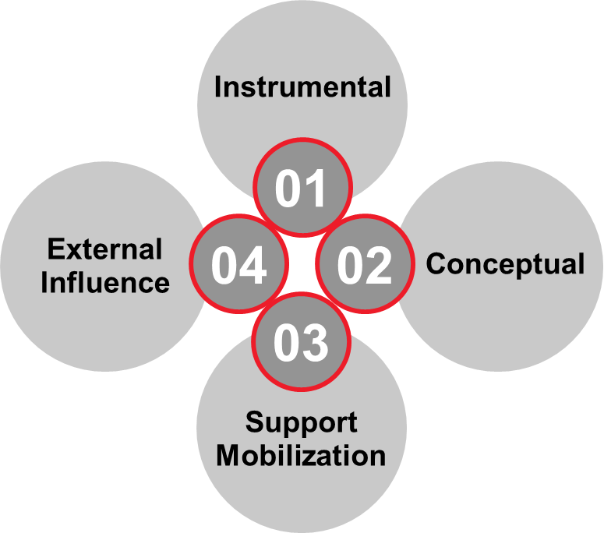
Lessons Learned: the Good Stuff
Our greatest contribution has been to create and share a measurement and reporting framework
We have influenced a lot of thinking, even though it’s not always obvious
We have sold over 1600 books; there is clearly a demand and market for this
Use and application may take different forms
Instrumental use (decisions, practices, policies)
Conceptual use (new ways of looking at the world)
Build support (for measurement and discipline in our field)
Influence stakeholders (business leaders outside of L&D)

Slide 5
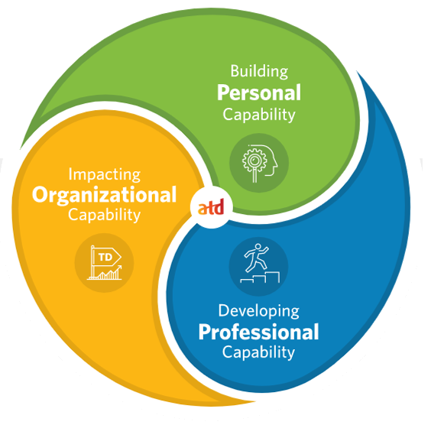
Recommendations
Start
Use the framework
Adopt the standard language for measurement and reporting
Increase your basic and intermediate measurement and reporting capabilities
Set goals or targets for key measures that you want to improve
Measure application on the job (at least intent) for key programs
Use monthly management reports to deliver planned results
Stop
Using dashboards for every reporting need
Hiring data scientists until you build the basic capabilities
Postpone
Don’t tackle the advanced topics (big data, predictive modeling, data mining, machine learning, and business intelligence*) until you have mastered the basics
*Suggested in the ATD capability model under Impacting Organizational Capability

Slide 6
Breakout #5: Discussion Lessons Learned & What Do We Need to Do Differently
For the next 27 minutes, we will put you into your breakout groups to share take-aways
Discuss
What lessons learned would you add to Dave and Peggy’s list?
What should we do differently?
We will bring you back after 27 minutes

Slide 7
Contact Information
Dave Vance
dvance@centerfortalentreporting.org
Phone: 970-217-4692
Peggy Parskey
pparskey@centerfortalentreporting.org
Phone: 323-449-3371

