Slide 1
Need for TDRP November 2, 2022
Dave Vance: Executive Director
Peggy Parskey: Assistant Director

Slide 2
The Need for Talent Development Reporting Principles (TDRP)
Lack of a comprehensive framework for human capital measurement and reporting
03
04
Lack of business acumen and the ability to speak the language of business
Need for TDRp
Lack of standard names and definitions for measures
02
05
Lack of respect for learning & development by senior leaders
Confusion among practitioners about
What to measure
How to measure
How to report
01

Slide 3
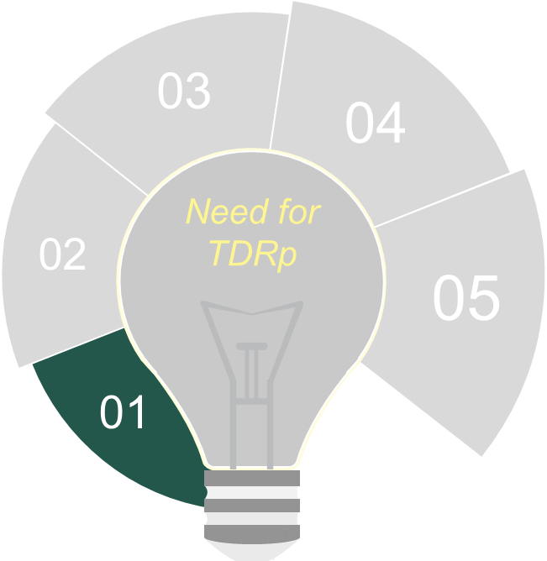
The Need for TDRP
Lack of a comprehensive framework for human capital measurement and reporting
Most professions have a common language and framework
Accounting, chemistry, biology, astronomy
What do we have?
Kirkpatrick and Phillips five levels for program evaluation measurement
Bersin’s 10 levels for measurement
Brinkerhoff case study method for program evaluation and improvement
No comprehensive framework for other L&D measures
Nothing for reporting

Slide 4
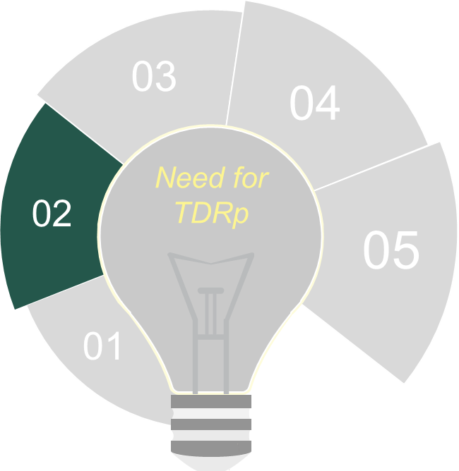
The Need for TDRP
Lack of standard names and definitions for measures
We have almost 200 measures for L&D
700+ for HR
Standardization of names and definitions would simplify our work and increase the value of benchmarking
Example: Participants
Unique or Total
Example: Completion rate
Completions / Target audience
Completions / Registrations
Completions / Attendees
Example: Level 4: Two definitions

Slide 5
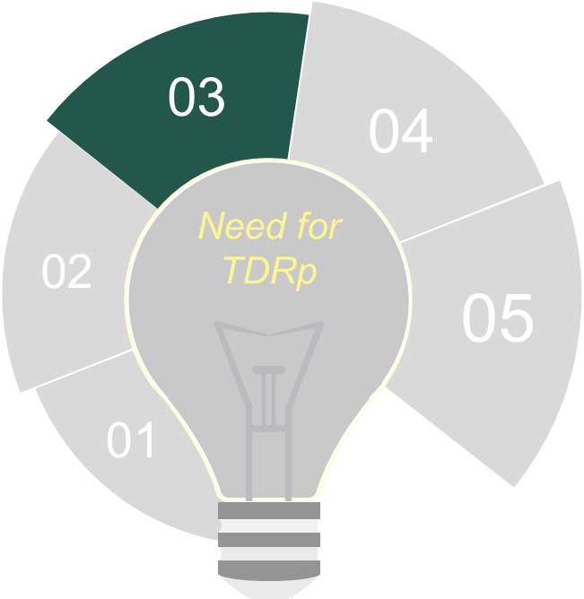
The Need for TDRP
Confusion among practitioners about
What to measure
How to measure
How to report

Slide 6
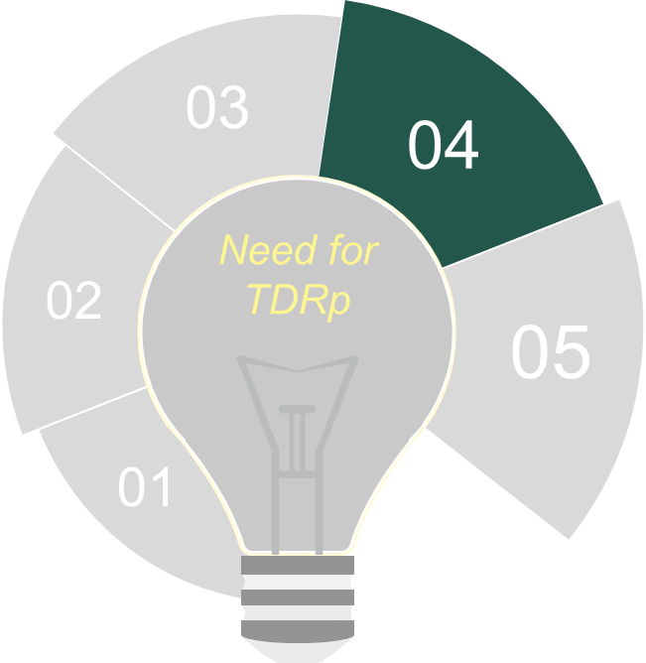
The Need for TDRP
Lack of business acumen and the ability to speak the language of business
Many L&D practitioners have not been exposed to other parts of the business or taken business courses
Consequently, we don’t know how to talk to business leaders and don’t know what they want

Slide 7
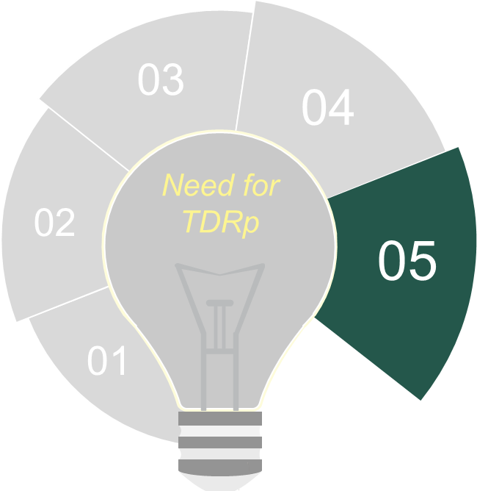
The Need for TDRP
Lack of respect for L&D
Many senior leaders don’t understand the contribution learning can make
Because we don’t make the business case for it
Or run it like a business
Consequently, they underfund it and cut it significantly during a downturn

Slide 8
Questions or Comments

