Slide 1
What TDRp Means for the Profession
Panel Discussion
November 2, 2022
Dave Vance: Executive Director
Peggy Parskey: Assistant Director

Slide 2
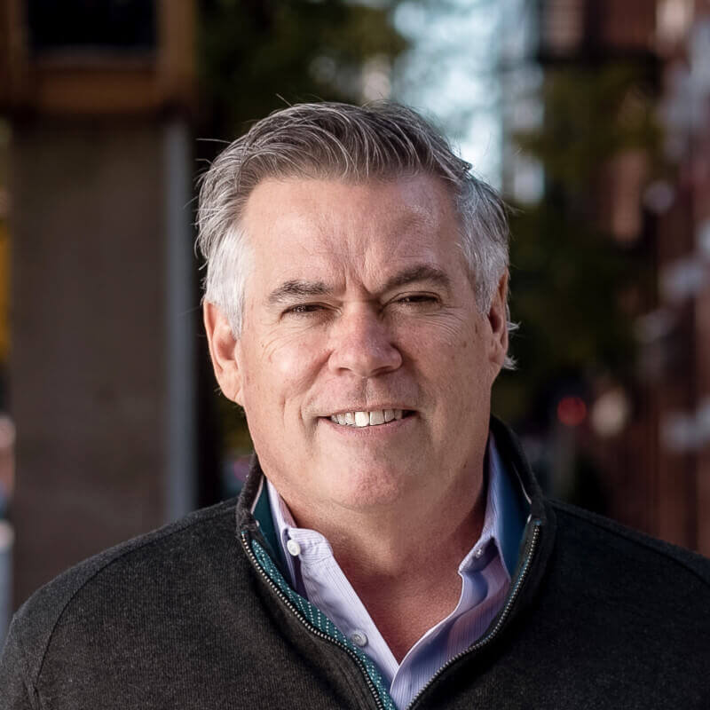
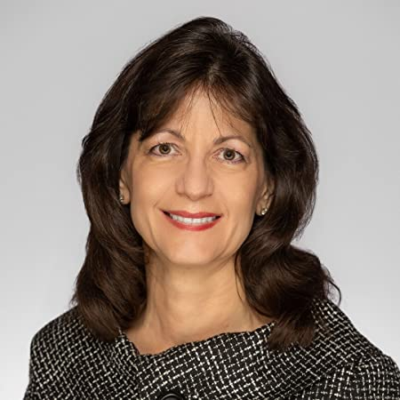
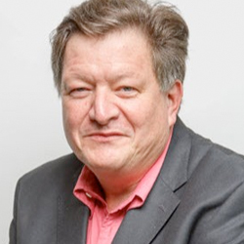
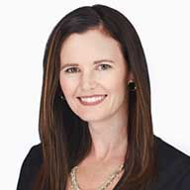
Our Panelists
Kent Barnett
CEO and Founder
Performativ
Patti Phillips, PhD
CEO
ROI Institute
Kimo Kippen
President
Aloha Consulting
Shawn Overcast
Chief Insights Officer
Explorance

Slide 4
What TDRp Means for the Profession
What are your insights about how the TRDp framework has helped L&D practitioners better understand and adopt measurement and reporting practices?
As a profession, we strive to demonstrate the impact of L&D on the business. In what ways do you feel that TDRp has impacted not just practitioners but also organizations and our profession?
What are the opportunities in the future? How do we improve adoption of this approach?

Slide 5
Q&A: What Questions Do You Have For Our Panelist?

Slide 6
Contact Information
Dave Vance
dvance@centerfortalentreporting.org
Phone: 970-217-4692
Peggy Parskey
pparskey@centerfortalentreporting.org
Phone: 323-449-3371

