Slide 1
Welcome to CTR’s
Ten-Year Anniversary Conference
November 2, 2022
Dave Vance: Executive Director
Peggy Parskey: Assistant Director

Slide 2
Thank you to our 205 participants from 20 countries!

Slide 3
A day exploring the
History, Present State, and Future of
L&D Measurement and Reporting
with a
Focus on TDRP

Slide 4
2022 CTR Conference
Welcome
  Breakout: Introductions
History of Measurement
  Breakout
Need for TDRP
History and Evolution of TDRP
  Breakout
15-minute Break
Current state of TDRP
  Breakout
  Q&A. Sharing
15-minute Break
Panel discussion on TDRP
Lessons learned
  Breakout
  Q&A. Sharing
Wrap up

Slide 5



Thank you! Conference Sponsors
Platinum
Diamond

Slide 6
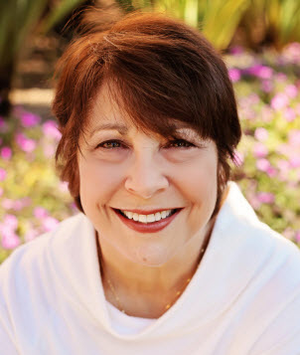
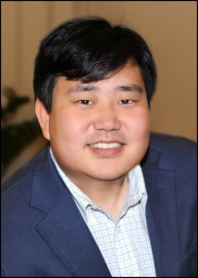
Thank you
Panelists
CTR Staff
  Peggy Parskey
    Assistant Director, CTR
    Workshops, webinars, certification, case studies
  Andy Vance
    Director of Operations and Member Support, CTR
    Event planning and logistics, membership, website, IT
Mercy Ehrler: Communications

Slide 7
Thank You
CTR Board and Advisory Council Members
CTR Board
Patti Phillips (ROI Institute)
Beth Gantz (Explorance)
Jeff Higgins (HCMI)
June Sonsalla (Thompson Reuters)
Adri Maisonet (BCBS North Carolina)
Jeff Carpenter (Caveo Learning)
Kimo Kippen (Aloha Learning Advisors)
Gary Whitney (Little Caesars)
CTR Advisory Council
Steve Lange (Explorance)
Michelle Eppler (Bellevue Human Capital Lab)

Slide 8
The Center for Talent Reporting:
The Home of TDRp
Established October 2012
  Nonprofit, member-based professional association (like ATD)
Mission
  Improve and standardize the measurement, reporting, and management of human capital to deliver significant business value
Offerings
  Webinars
  Measurement and Reporting Workshops
  Coaching
  Annual conference
  Corporate memberships
  Certification and accreditation

Slide 9
Logistics
Agenda is available at CTRconference.com and sent yesterday
All participants will be muted upon arrival. Please unmute in breakouts and if we call on you and then mute when you are done.
Use chat to ask questions or make comments during presentations
  Raise hand during Q&A to speak or use chat
PowerPoints and recordings will be available on the Session Files and Recordings tab on Monday November 7
Contact Andy Vance if you have any technical issues
  Avance@CenterforTalentReporting.org
  Call or text Andy at 309.696.1382
  Private chat to Andy

Slide 10
Thank you! Conference Sponsors
Platinum
Diamond

Slide 11

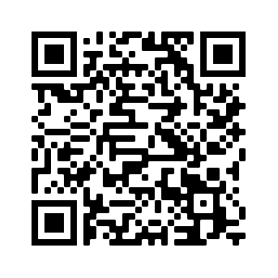
The Global Leader in Measurement and Evaluation
Helping Clients Create and Demonstrate the Value of Programs, Projects and Initiatives Through:
  ROI Certification for building serious evaluation capability
  Workshops and other learning opportunities
  Consulting and coaching
  Publications such as books, case studies, guides, and tools
  Speaking and presenting at conferences worldwide
  Research and benchmarking
Download Resources
https://bit.ly/CTR2022ROI
+1.205.678.8101 • WWW.ROIINSTITUTE.NET • INFO@ROIINSTITUTE.NET

Slide 12





Years of L&D Experience on our Leadership Team.
Measurement & Analytics is All We Do.
Introducing Performitiv
Performitiv empowers Fortune 500 companies and world-class learning organizations to use data to more effectively develop leaders, increase sales, improve onboarding, and drive higher performing workforces.
We offer simple, fast, flexible learning analytics and BI technology, along with the strategic guidance you need to dramatically improve the impact of your talent investments.
www.performitiv.com
Technology
Guidance
Methodology

Slide 13

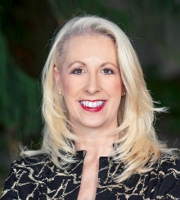



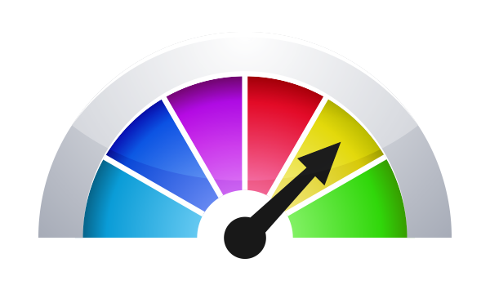
Dr. Michelle Kempke Eppler
Associate Vice President
Human Capital Lab
Dean, College of Arts & Sciences
eppler@bellevue.edu
HCLab@bellevue.edu
Align
Design
Measure
Notes:
Bellevue University’s Human Capital Lab is all about making learning work to your strategic advantage.
We do this three ways:
• We help you align learning programs with strategic intent. This can include competency mapping, engagement assessment, and soft skills (Power Skills) assessment
• We work with you to design custom learning programs that meet strategic needs.
• We measure the impact of learning on corporate strategic goals.

Slide 14

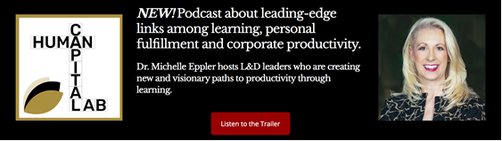



Notes:
For more about Bellevue University’s Human Capital Lab, head to humancapitallab.org.

Slide 15

Breakout #1: Introductions
For the next 8 minutes we will go into Breakouts for introductions
  Breakouts are not recorded
Share
  Name, organization, position
  Years of experience with measurement and reporting
  Select representative to enter average years of experience with measurement
We will bring you back after 8 minutes

